Slide 1

The challenge of
Digital Preservation at CERN
Antonio Vivace // PV2023 - May 3rd 2023 // avivace@cern.ch

Slide 2
Contents
Preservation Scope
Scenarios
Digital Preservation
Creating SIPs
Platform
Architecture overview
Features
Technology
Further improvements

Slide 3



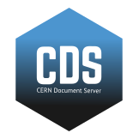


Preservation Scope
Digital Repositories in use at CERN
Local folders (user provided content)
E.g. Slides submitted to external conferences, notes, drafts
Notes:
Different type of data coming from different kind of repositories

Slide 4
NOT
Another digital repository A backup
But… Policies, infrastructures and technologies to face challenges of file corruption, media failure and technological (hardware and software) obsolescence, following OAIS principles

Slide 5
Scenarios
Repositories periodically selecting and submitting resources for long term preservation
service implements preservation (AIPS) and register them to DM platform
service submits SIPs to DM platform
service request DM platform to harvest their resources
CERN users want to preserve their assets
released on digital repositories
local files
-> CERN Digital Preservation Strategy

Slide 6
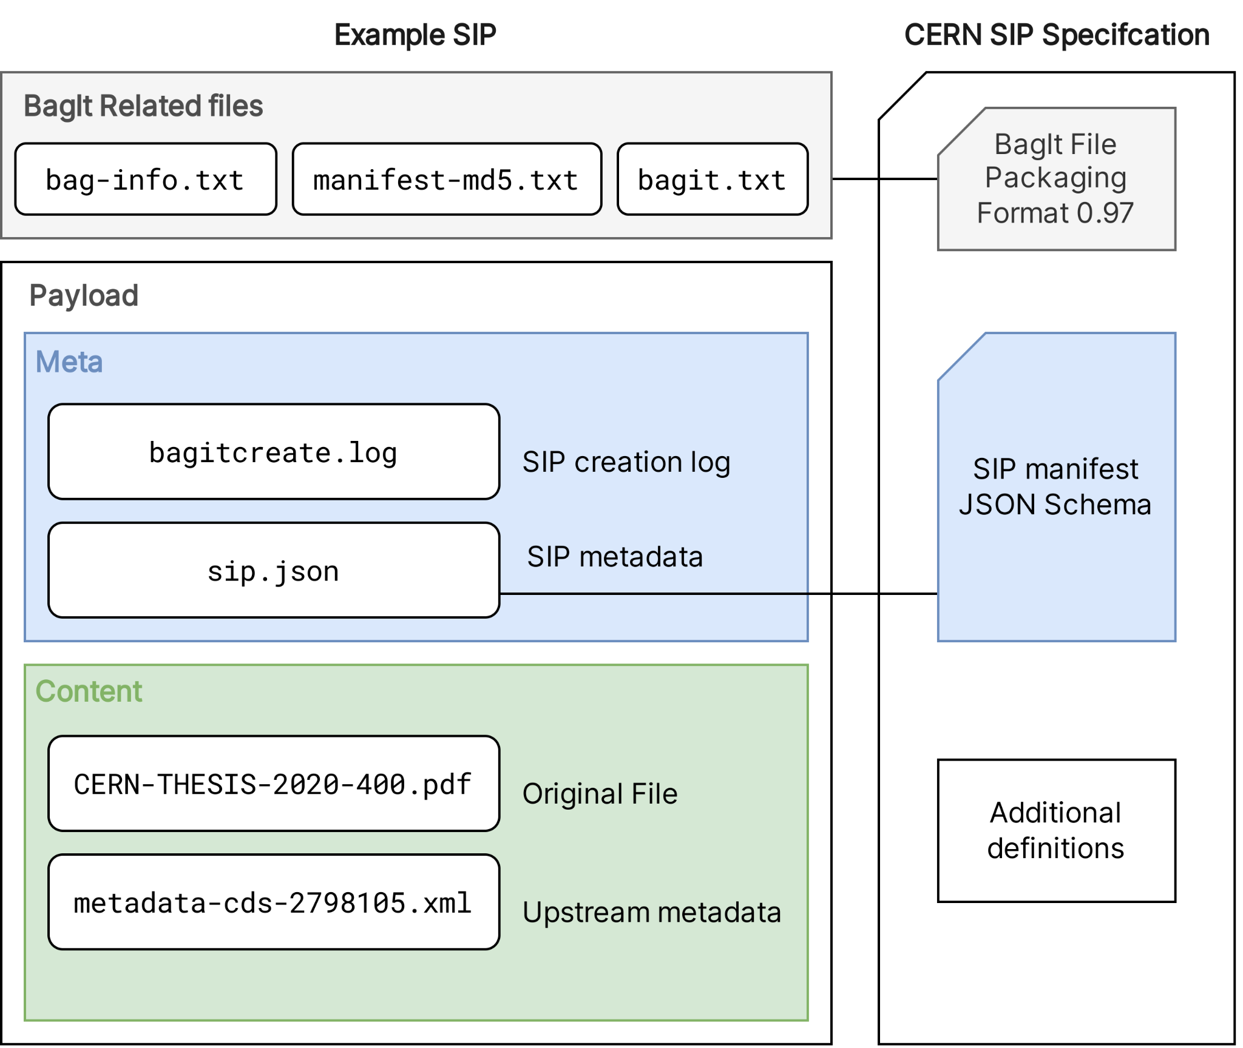
Creating SIPs
BagIt Create a tool to harvest data and export digital repository records in packages with a consistent format, according to a well defined specification - -> CERN SIP Spec
CLI or as a software package
$ bic --source cds --recid 2748063

Slide 7
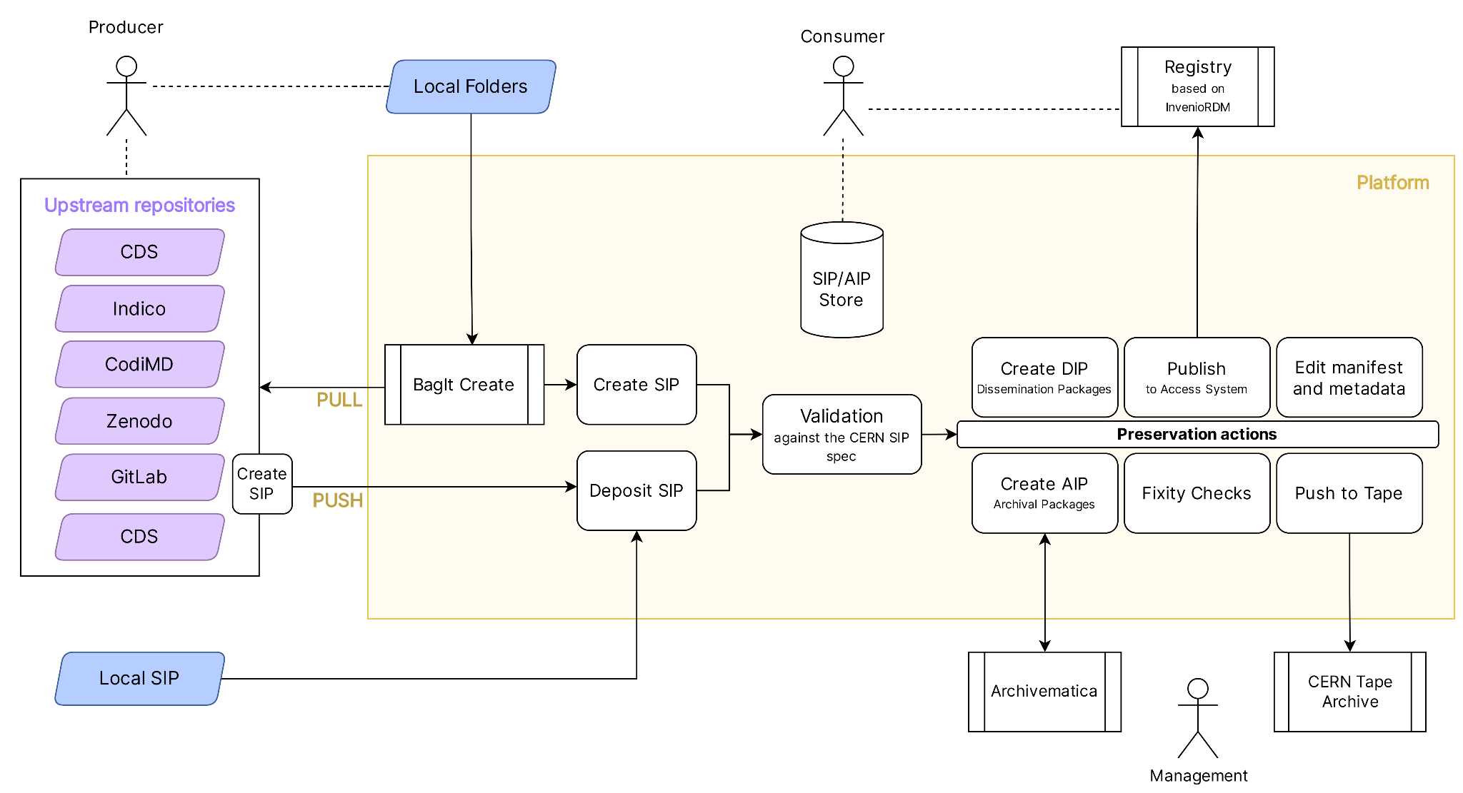
Platform overview

Slide 8


Features
SIP creation with BagIt Create
AIP creation with Archivematica
Push to Tape and Retrieve from Tape (CTA)
(Optional) additional curation for local resources
Fixity checks
Dissemination and access to the archives

Slide 9
Technology
Dev (and Git) Ops oriented approach to deployments
Everything modular and OSS, with detailed documentation for usage and development
CERN specifics documented and easily un-pluggable
Platform: a Python Django restful web application
OpenAPI specs
Frontend in React
Registry powered by InvenioRDM

Slide 10
Further improvements
Moving SIP creation to the repositories
Appraisal and content selection
Archivematica and the support for Office documents
Access to the Registry

Slide 11
References & Links
CERN Digital Preservation Strategy: proposal http://cds.cern.ch/record/2856775
BagIt Create https://gitlab.cern.ch/digitalmemory/bagit-create
OAIS Platform https://gitlab.cern.ch/digitalmemory/oais-platform
CERN SIP Specification https://gitlab.cern.ch/digitalmemory/sip-spec
Format Policies https://wiki.archivematica.org/Format_policies
The Challenge of Digital Preservation at CERN https://cds.cern.ch/record/2857550

Slide 12
Backup

Slide 13
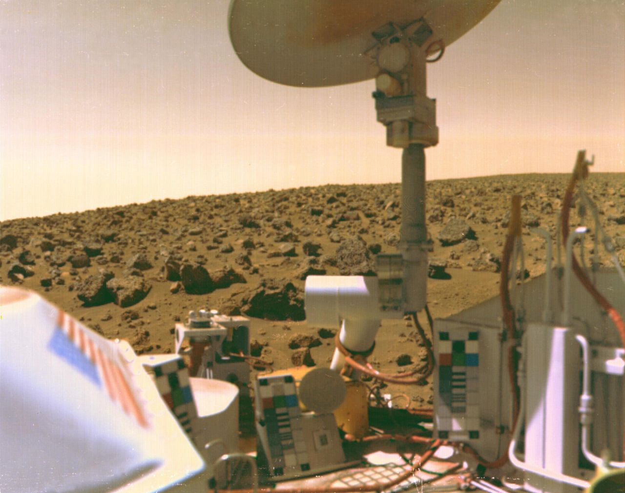
Risks & Challenges
Media which cannot be read
Information trapped in legacy systems
Incomplete metadata and uncomplete context
Unclear ownership & provenance
Corrupted or deleted files
Expired software licenses
Expired vendor supports
Lossy conversions or migrations
-> Digital Dark Age
Notes:
A famous example is NASA, whose early space records have suffered from a dark age issue more than once. For over a decade, magnetic tapes from the 1976 Viking Mars landing were unprocessed. When later analyzed, the data was unreadable as it was in an unknown format and the original programmers had either died or left NASA. The images were eventually extracted following many months of puzzling through the data and examining how the recording machines functioned.^{[7]} The original moon landing tapes were likely erased and reused, with the only video recordings of the Apollo 11 landings being later copies.^{[8]}

Slide 14
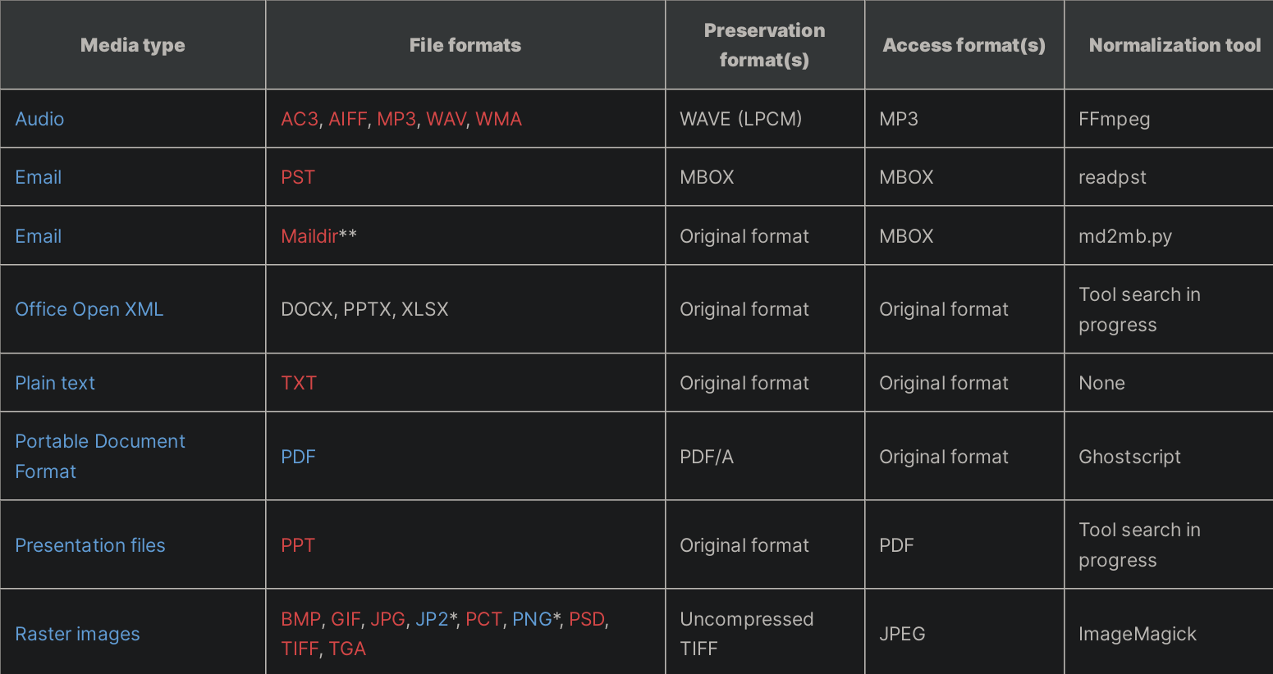
Archivematica default format policies
Notes:
Archivematica's primary preservation strategy is to normalize files to preservation and access formats upon ingest. Archivematica's preservation formats are all open standards. Additionally, the choice of preservation format is based on community best practices, availability of open-source normalization tools, and an analysis of the significant characteristics for each media type. The choice of access formats is based on the ubiquity of viewers for the file format.

Slide 15
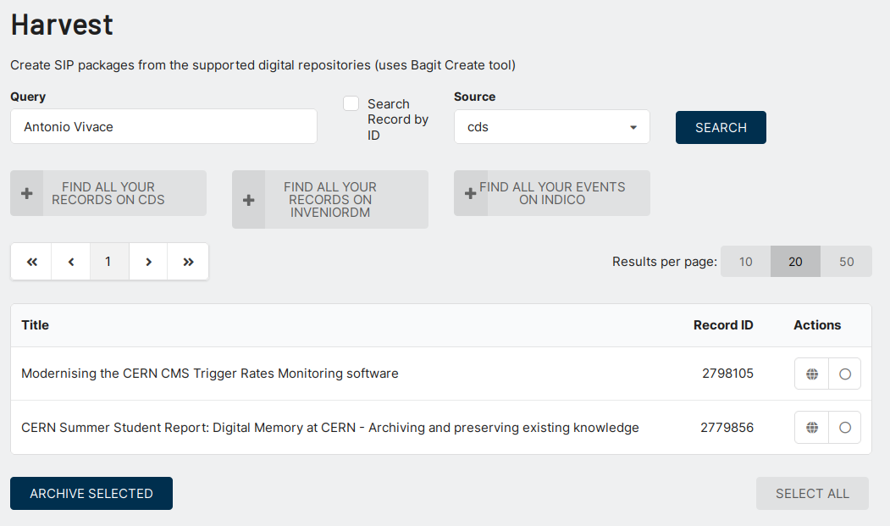
Harvest UI

Slide 16
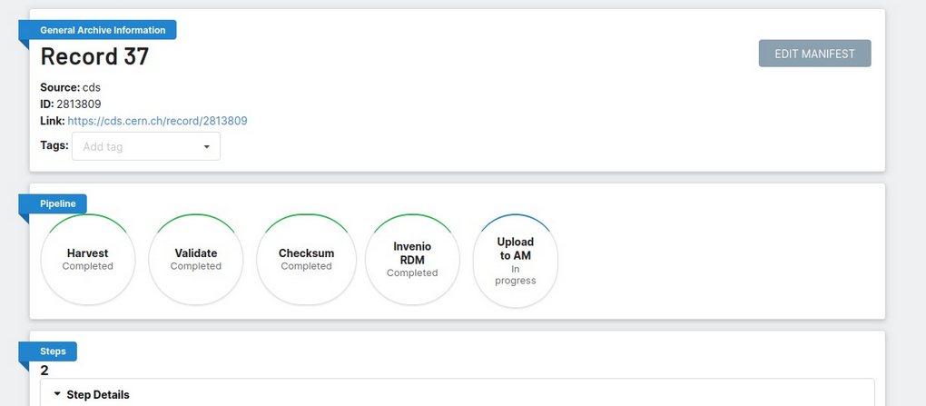
Pipeline overview

Slide 17
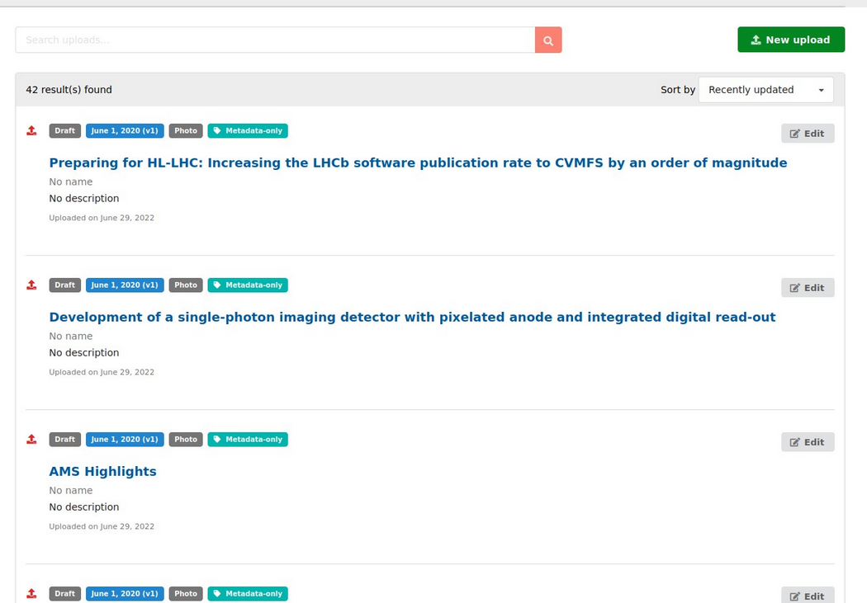
Registry
results

Slide 18
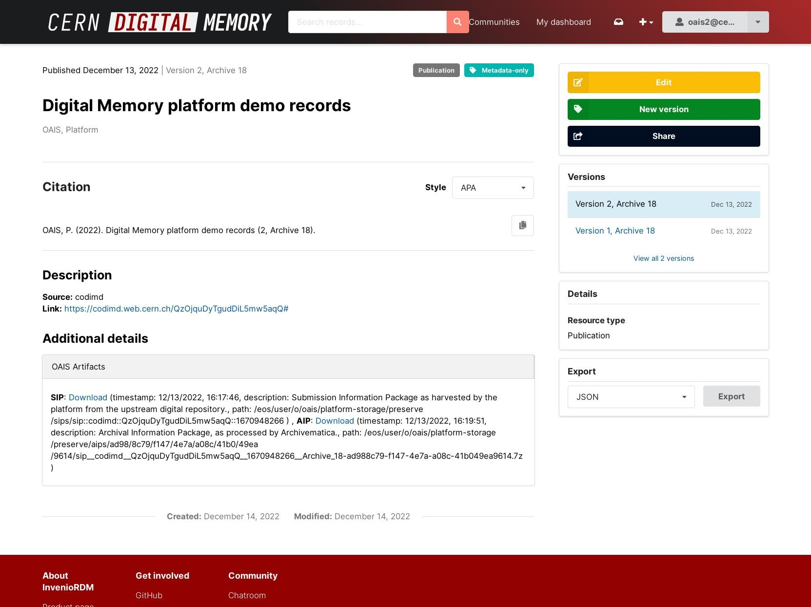
Registry
example

